Slide 1
Introduction
Class 1
G Sudha Sadasivam

Slide 2
Agenda
About the course
Translation process
Need to study compiler design
Analysis synthesis model
Analysis phase tools
Compiler vs interpreter

Slide 3
About
6 units
Introduction – related compiler tools, phases, grouping, errors
Lexical analysis- role, RE, NFA, DFA, conversion, minimisation, LEX
Syntax analysis – CFG, Top Down Parsing: Recursive & Rec Descent, Predictive parsing LL(1) parser. Bottom Up Parsers: Shift Reduce , Operator Precedence LR-SLR, CLR and LALR , error, YACC
ICG- TAC – statements case, declaration, arrays, bool expr, backpatching, case, procedure calls
Runtime – storage organisation, paramter passing, symbol table,
Code opt & generation: local & Global Optimization Data Flow analysis, Issues in Design of A Code Generator - A Simple Code Generator Algorithm.

Slide 4
Alfred V Aho, Monica Lam, Ravi Sethi and Jeffrey D Ullman, “Compilers - Principles, Techniques and Tools”, Essex Pearson, Harlow, 2014.
CA test marks – open book
Tutorials - open book
Class Tutorials

Slide 5
INTRODUCTION TO COMPILERS
Translators - Compilation and Interpretation - The Phases of Compiler - Errors Encountered in Different Phases - The Grouping of Phases - Compiler Construction Tools

Slide 6
A translator is a software that converts a source text from one language to another language.
The language in which the translator is written is called the implementation language.
The input text is called the source program
The output text is called the target program.
When the target language in the translator is a low level language, the translator is called as the compiler.
When the source language is also the implementation language and the source text to be compiled is actually a new version of the compiler itself, the process is called bootstrapping.

Slide 7
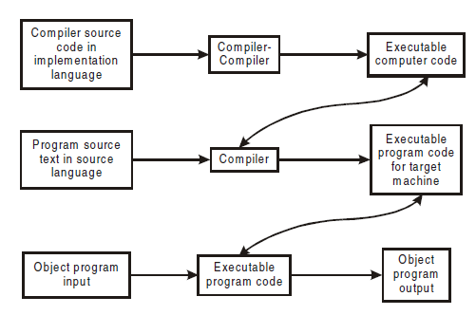

Slide 8
Why study compiler design?
A good Pilot / driver needs knowledge on plane/car
Provides the theoretical and practical knowledge that is needed to implement a programming language.
Use sophisticated algorithms and data-structures
Study & implement, re-engineer complex software systems
Automated tools for migrating tools from one platform to another
Design and implementation of efficient opt techniques
XML parser, NLP --- based on the theory of compilers

Slide 9
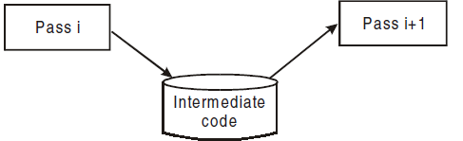
Analysis Synthesis Model
Unit – part of the source prgm like expression
Pass - A compiler pass is one complete scan of the source program or its equivalent representation
Multiple passes

Slide 10
Need for multiple pass
Forward Reference : goto 100 🡪 solved when storage allocation in the first pass and generating code in the next pass.
Storage limitation (RAM) – pass’s output can be stored in a disk and can be read by another pass
Optimisation: IC generated can be made space and time efficient (irrespective of the PL) using control and data flow graphs
The phases of compilation connected with code analysis form one pass and the remaining portions (code generation) form the next pass of the compiler

Slide 11
Analysis – Synthesis Model
Analysis / front end :
Performs analysis of source program. Defined by the grammar of the source language
Determines the meaning of the source program
Is isolated from back end and generates intermediate code for the back end.
Synthesis / back end :
Synthesizes / generates the target program
Generates target string from the source string using the semantic actions produced by the front end of the compiler.
Depends on pragmatics ( execution environment ) including target machine / OS

Slide 12
Phases
Each pass is divided into various sub-steps (phases)
A phase is a logically cohesive unit that takes as input one representation of the source program and produces as output another representation of the source program.
Phases of Analysis pass:
lexical analysis phase : Determination of lexical constituents in a source string
Syntax analysis phase : Determination of the structure of the source string
Semantic analysis phase : Determination of the meaning of the source string.
Phases of Synthesis pass:
1. Optimisation of code.
2. Allocation of memory.
3. Generation of code.

Slide 13
Analysis Tools
1. Structure editors: analyzes the program text and represents it as an hierarchical structure. It also checks for keywords and parenthesis matching.
2. Pretty printers: realigns the structure of the program, changes its font and prints it with indentations.
3. Static Checker: discovers potential bugs in prg. For example, it can identify dead portions of a code.
4. Interpreter: During synthesis phase, it traverses the tree and executes the operation at each node (rather than generating a code for it).

Slide 14
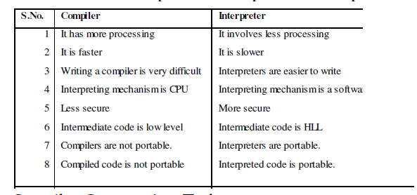

Slide 15
5. Text formatters: takes as input a stream of characters, which have to be type set along with the commands to indicate the paragraphs, figures and mathematical structures.
6. Silicon Compiler: has the source language similar to the conventional programming language. Here the variables represent the logical signals (0 or 1) in a switching circuit.
7. Query Interpreter: translates a predicate language having relational and boolean operations into commands to search the database for records satisfying thepredicate

